Slide 1
INTRODUCTION
The team and why we chose to help with this application need
Notes:
Damian

Slide 2




Framework
(Next.js)
Hosted on
Hosting (Vercel)
Database (Supabase)
Auth (Clerk)
Cost
$25/month After 10 000 MAUs
Cost
$20/month
Cost
$25/month
Total Costs
Best $45/month
Total Costs
Best $20/month
Total Costs
Best $45 - $70/month
Notes:
Damian

Slide 3

BACKGROUND
Horse Stud
Established in 1993
Mostly Manual
Expansion
Notes:
Ruan

Slide 4
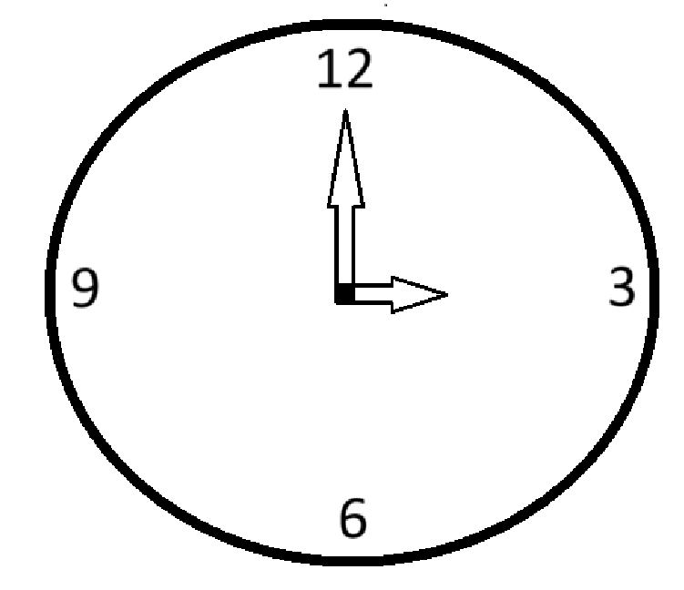
CHANGE DOCUMENT
Easily Expandable
Independent system
Save Time
24/7
Notes:
Ruan

Slide 5
GITHUB
The layout and the pipeline testing’s using the devops document
Notes:
Christiaan

Slide 6
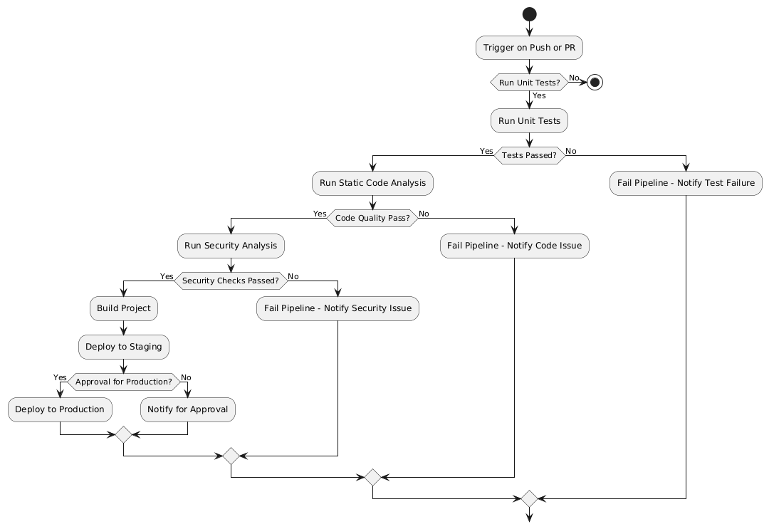
Documentation: DEVOPS Practices
GitHub Actions Pipeline - Pipeline Steps:
Code Integration: Triggered on code push, pull request, or merge.
Unit Testing: Verifies functionality; generates test reports.
Static Code Analysis: Tools (SonarQube/CodeClimate) enforce standards and identify code issues.
Security Testing: Tools (CodeQL/Snyk) scan for vulnerabilities.
Build & Deployment: Deploys to staging for review. Approved code is moved to production.
Monitoring & Notifications: Real-time alerts for health and metrics.
Reports
Unit Test Report: Details passing/failing tests.
Static Analysis Report: Highlights code quality metrics.
Security Testing Report: Lists vulnerabilities with corrective actions.
Tools
Static Code Analysis: SonarQube/CodeClimate for maintainability and duplication checks.
Security Testing: GitHub CodeQL/Snyk for identifying critical vulnerabilities.
Notes:
Christiaan

Slide 7
APPLICATION
What type of application and the features it gives
Notes:
Damian

Slide 8
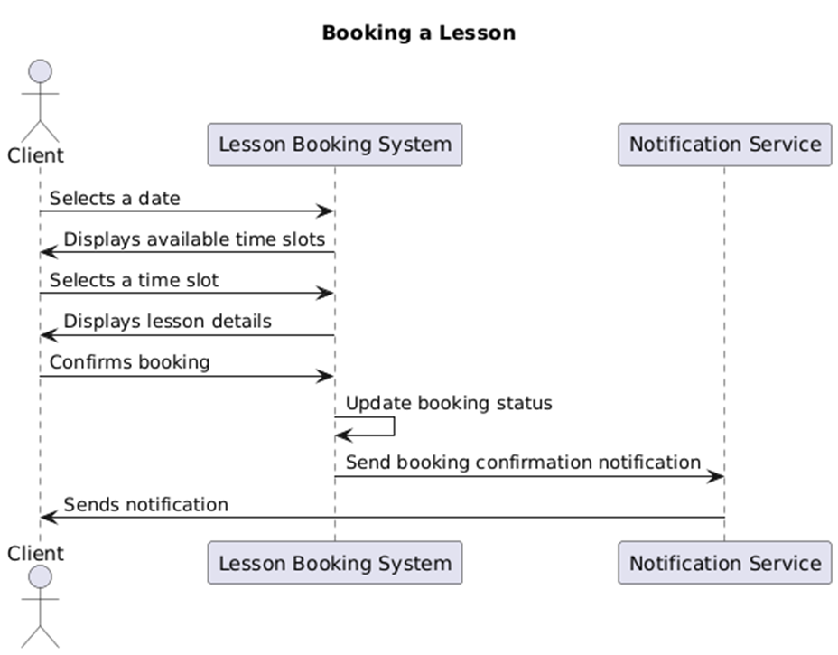
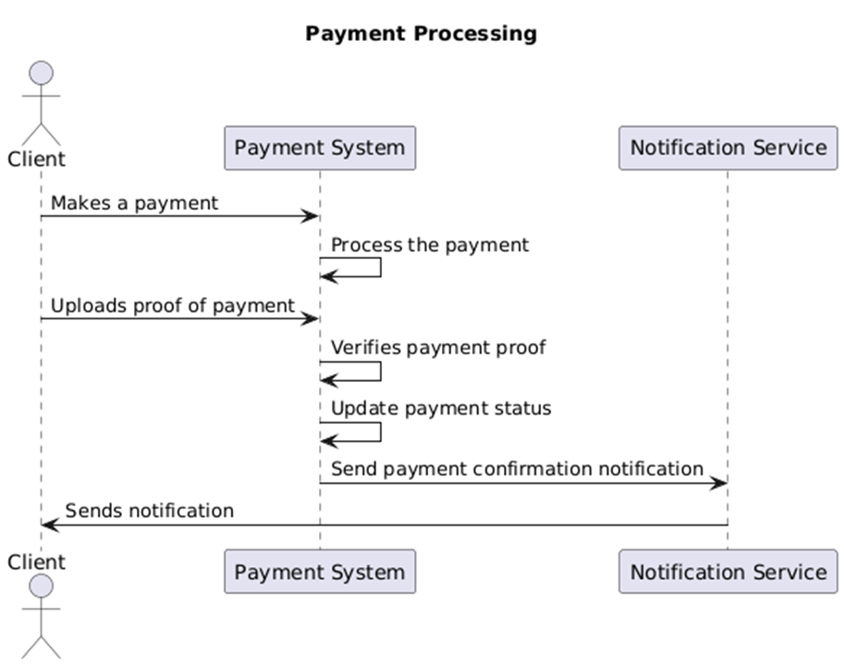
Documentation: Analysis Artifacts
Key Bounded Contexts:
• User Management Context:
- User authentication, profiles, and role-based access.
- CRUD operations for user roles (Client, Coach, Admin).
• Lesson Booking Context:
- Schedules lessons and manages booking confirmations.
• Payment Management Context:
- Processes payments and tracks history.
• Lesson Management Context:
- Manages lesson details and assignments.
• Notification Context:
- Customizes alerts for events.
Design Artifacts:
• Domain Model Analysis:
- Focus on user roles, lesson booking, payments, and notifications.
• Implementation Highlights:
- User roles with distinct permissions.
- Structured lesson management and scheduling.
- Streamlined payment integration.
Notes:
Guilliaume

Slide 9
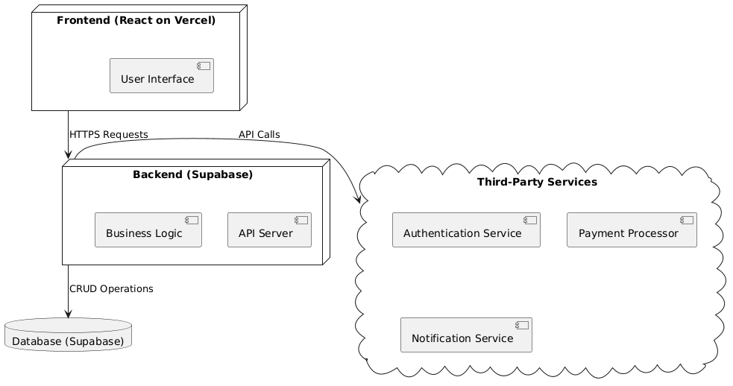
Documentation: Architecture Artifacts
Cloud Architecture:
• Frontend: React on Vercel for scalability and flexibility.
• Backend: Supabase with PostgreSQL for managed database and built-in authentication.
• Integrations: Secure third-party API integration for authentication, notifications, and payments.
Notes:
Guilliaume

Slide 10
Documentation: Implementation Docs
System Architecture
Frontend: Modern frameworks for a responsive interface.
Backend: RESTful API for business logic and database interactions.
Database: Cloud-hosted relational database for secure data storage.
Third-Party Services: Authentication and cloud storage for scalability.
Critical Flows
Lesson Booking Process:
User selects a time slot.
System verifies availability.
Booking confirmation is saved in the database.
Lesson Management:
Coach/Admin manages schedules (create/edit/delete).
Updates are applied to the database.
Payment and Booking Confirmation:
User pays via a secure gateway.
Payment status is updated in the system.
•
Deployment
Environments: Development, staging, production.
Key Steps:
Hosting on Vercel (frontend) and Supabase (backend).
Environment configuration (API keys, database URLs).
Build and deploy with end-to-end testing.
Related Documentation
Database Schema: ER diagram defines relationships between entities (e.g., User, Lesson, Payment).
API Documentation:
Endpoints for scheduling, payments.
Secure authentication via tokens.
Error Handling:
Centralised logging and error codes for debugging.
•
Notes:
Guilliaume

Slide 11
Documentation: Non-Functional Requirements Based on ISO/IEC 12207
Performance
Response within 7 seconds for 5,000 concurrent users.
100 concurrent transactions/second.
Implementation: Optimised server-side rendering, database indexing, caching.
Scalability
Support for tenfold increase in users and transactions.
Dynamic and horizontal scaling via Vercel and Supabase.
Reliability
95% uptime, 1-hour MTTR.
Regular backups and redundancy implemented.
Maintainability
Modular design for easy updates.
Comprehensive code and architecture documentation.
Security
Role-Based Access Control (RBAC) with Clerk.com.
Data encryption in transit and at rest.
Usability
Responsive, consistent interface for all devices.
Accessibility for users with disabilities.
Interoperability
REST APIs for seamless system integration.
Compatibility with all browsers and devices.
Regulatory Compliance
POPIA-compliant with informed consent mechanisms.
Secure user data protection and limited data collection.
Notes:
Guilliaume

Slide 12
Documentation: Functional Requirements
User Roles
Client: Access to booking and limited functionality.
Coach: Manages lessons, participants, and skill levels.
Admin: Full system access, including lessons, users, and configurations.
Key User Stories
Clients:
Book skill-appropriate lessons with detailed lesson and payment information.
View booked and pending lessons with status indicators.
Coaches:
Add, edit, and manage lessons with participant details.
Update skill levels for users and horses.
Admins:
Create, view, edit, and delete lessons, users, and horses.
Manage contact, payment, and address details.
Critical Features
Lesson Booking:
Calendar-based selection with availability verification.
Integrated payment and proof submission.
Lesson Management:
CRUD operations for lessons with detailed configurations.
Data Management:
Manage users, horses, payment, and contact details with filters and search functionality.
Notes:
Guilliaume

Slide 13
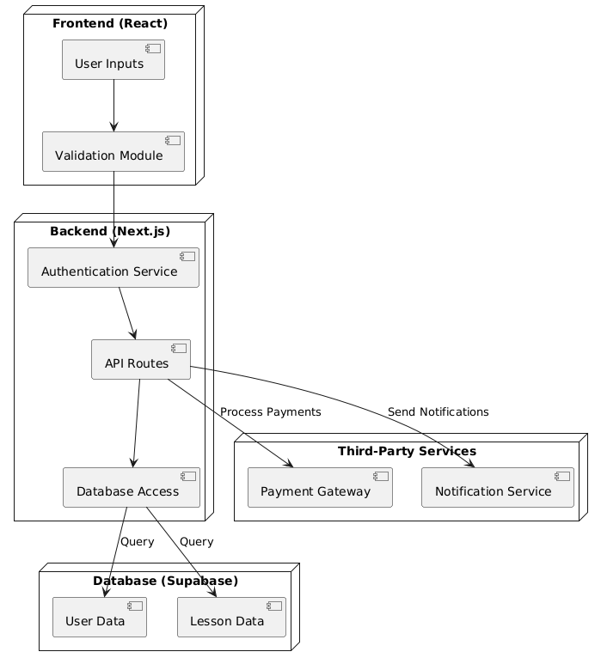
Documentation: Security
Security Architecture
Frontend (React):
Validates user inputs and prevents XSS attacks.
Secure communication via HTTPS.
Backend (Next.js):
Role-based access control (RBAC).
API request validation and session token management.
Database (Supabase):
Row-level security (RLS) and encryption.
Periodic backups ensure data recovery.
Third-Party Services:
Secure payment processing and notification systems.
Threats and Mitigations
Potential Threats:
SQL injection, XSS, social engineering.
Weak passwords and unsecured APIs.
Mitigations:
Input validation and multi-factor authentication (MFA).
Secure tokens, HTTPS for encrypted communication.
General Security Measures
Authentication and RBAC for controlled access.
Encryption for data in transit and at rest.
Complete mediation: Validating every request.
Notes:
Guilliaume

